Slide 1


Survival Curves
What do they tell?

Slide 2
End of accrual
End of study
6 years
A
B
C
D
E
F
How can we describe this data?
2 years
Mean survival+ SD
Median survival+ range
4 years
1 2 3 4 5 6 7 8
Time

Slide 3
End of accrual
End of study
How do we describe this data??
A
B
C
D
E
F
6 years
End of study
8 years
4.5 years
?
2 years
Loss to followup
5 years
4 years
End of study
1 2 3 4 5 6 7 8
Time

Slide 4
Reported as Proportion survived at a particular time point
83% at 4 years/ 50% at 5 years
All participants have to be followed up till the time point.
Ignores the time of event before or after that particular time point.
A
B
C
D
E
F
1 2 3 4 5 6 7 8
Time
Notes:
Difficult to study diseases where events take a long time to occur.
Does not differentiate if the patient died at 3 yrs vs 1 year or lived for 6 years vs 10 years.

Slide 5
Kaplan Meier survival curve
Time to event curve is a better term.
Has utility beyond survival analysis.
  Time to disease progression
  Time to drug resistance
  Time to change in therapy
  Time to tumor marker elevation
Can be used
Where we need to quantify the time to occurrence of the event.
Where event can be defined clearly.
Where all the participants may not experience the event.
No need to know how to create the plot. Statistical software would do it for us.
But we need to know when to use it and what it means.

Slide 6
Terminologies
Event-
  Outcome of interest
  well defined, unequivocal eg. Death, progression, relapse
Censored-
  lost to follow up, quit study, no event till end of study period
Median time to event
Rate of event (at particular time point)
Number at risk
Effect size
P-value
When comparing two or more study arms

Slide 7
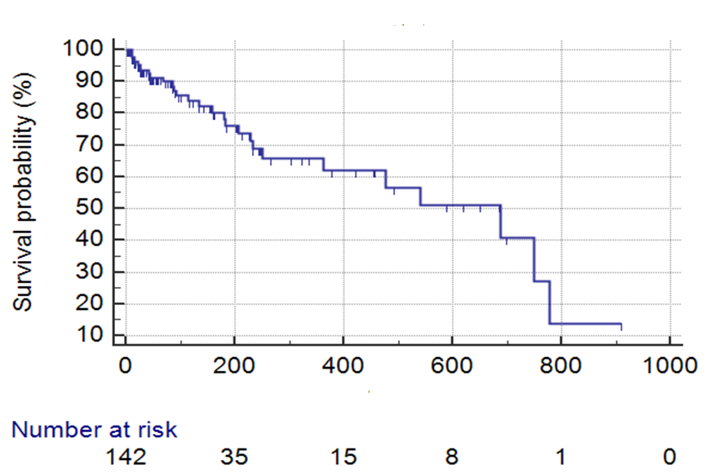
The drops are events

Slide 8
The dashes on flat line of plot means censored

Slide 9
Median time to event ~550

Slide 10
200 days event rate is 75%

Slide 11
Kaplan Meier “ESTIMATE”

Slide 12
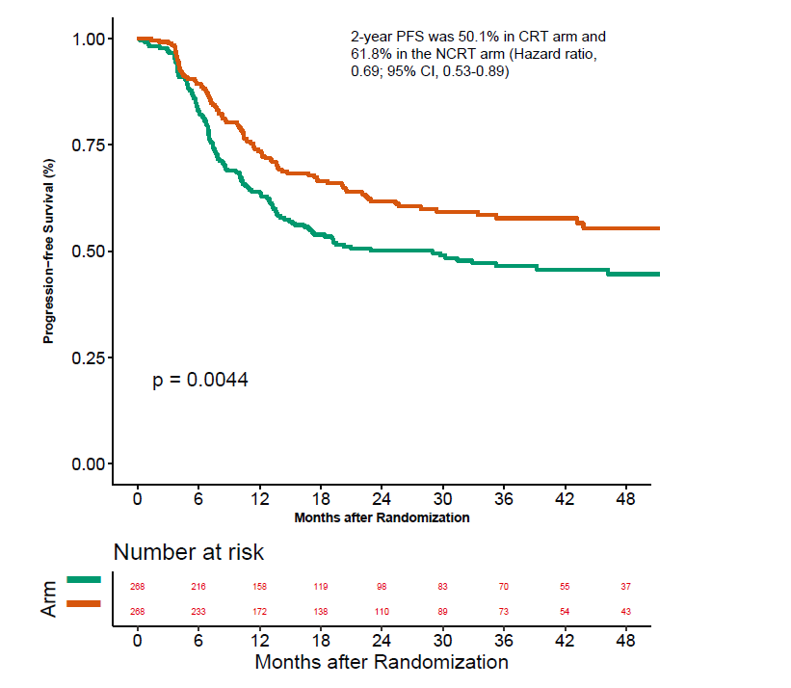
Comparing curves
Hazard ratio
  Measure of relative effect
  Uses the whole curve
  Accounts for time of event
Confidence interval
  The true effect lies between 0.53 and 0.89, 95% of times
P- value
Log Rank test
Cox Proportional Hazard
Study arm - A
Control arm- B
HR 0.69; 95% CI 0.53-0.89
Patil et al Cancer 2019
Notes:
HR- The risk of an event is same across the whole curve. Accounts for time of event
RR- The risk of having an event or not at one time point like end of study. Ignores time of event.
Cox proportional hazard model can compare multiple variates at the same time.

Slide 13
Different interpretations of the same curve
Hazard ratio
Median survival
  B arm-23 months
  A arm- not reached
Survival at a time point
  @24 months
  A- 62%, B-50%
Study arm - A
Control arm- B
Notes:
HR- measure of relative effect
Median and landmark analysis- measure of absolute effect but measures at only one time point. Ignores other timelines.

Slide 14
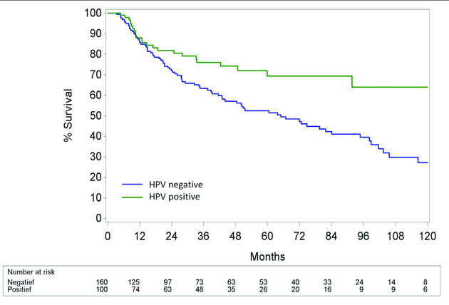
Curves are hugging till 12 months- no benefit
Curves separate after 12 months
Plateau – signifies possible lasting benefit.
Needs longer followup

Slide 15
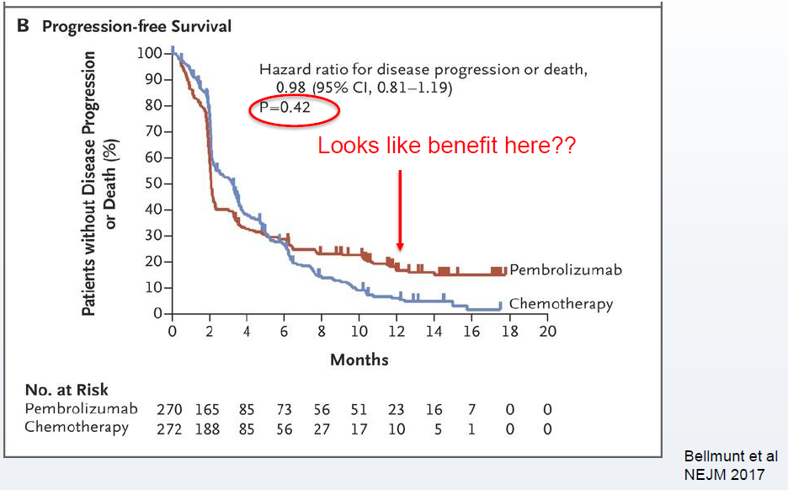

Slide 16
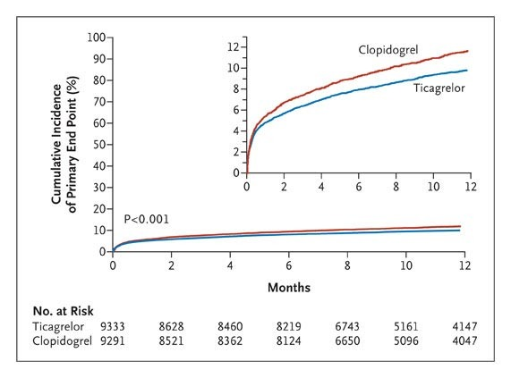
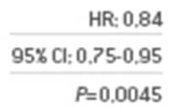
Absolute benefit ??
Clinically significant benefit?
NNT
Cost- resources
Toxicity

Slide 17
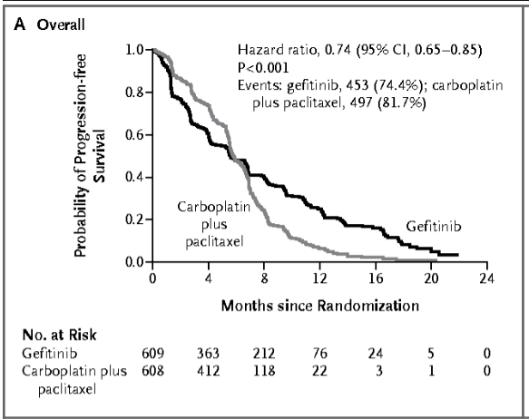
Mok et al NEJM 2009
HR>1
HR , CI or p value alone cannot adequately explain this curve.
HR<1

Slide 18
Survival curve is a simple, yet powerful way to express multiple information about events in a study.
We need to look beyond just p- value for proper interpretation of the data.
As clinicians we need to correlate the statistical effects (visual analysis, HR, CI, p value) and the clinical significance (cost, resource consumption, toxicity) to translate the data in to clinical practice.

Slide 19
Thank You
All participants
AOGIN
CREDO 2020- Dr Allan Hackshaw
Happy to take questions/ comments…..

